Slide 1
TRANSMUTING UNEQUALLY SPACED DATA:
A MIDAS regression touch to forecast real GDP growth in Brazil

Slide 2
INTRODUCTION
01
SUBJECT
Forecast real GDP growth in Brazil using Mixed Data Sampling (MIDAS).
02
PROPOSED METHODOLOGY
MIDAS regression allows the independent and dependent variables to be sampled at various and different frequencies.
03
PROBLEM
Unequally spaced data.
GDP is measured in quarters while most of the activity data is released monthly.
How to aggregate high-frequency data?
04
RESEARCH QUESTION
Can MIDAS outperform the AR(1) and the unrestricted Midas for out of the sample recursively estimated nowcasts?

Slide 3
LITERATURE REVIEW
Introduced by Ghysels, Santa-Clara and Valkanov (2002), (2003), (2005) and further developments in Ghysels, Sinko and Valkanov (2007):
03
Estimator properties
01
Goal
Safeguard information without parameters proliferation.
02
Proposed methodology
Lag polynomials
MIDAS
Lag Regressions
Consistency
Similar to Lag Regressions;
Finer sampling of data eventually eliminates discretization bias.
Efficiency
In some cases, asymptotic efficiency compared to lag regressions efficiency;
More efficient than flat-weighted aggregation.
Weight X_{i}
Select lags

Slide 4
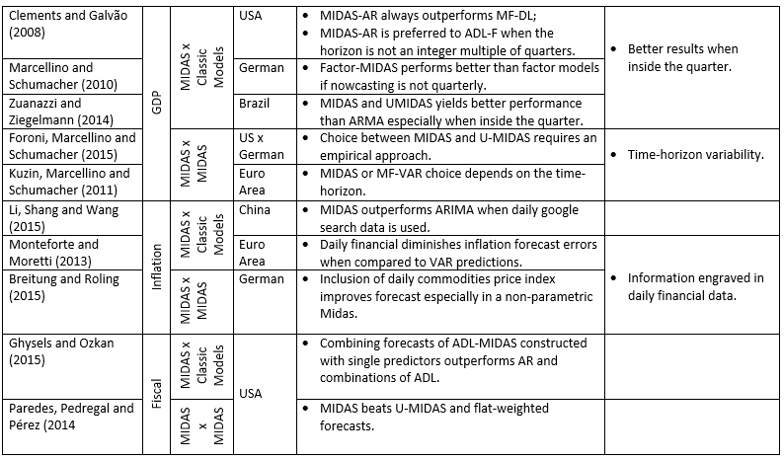
LITERATURE REVIEW

Slide 5




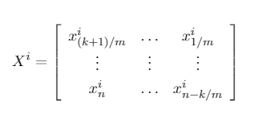

METHODOLOGY: MIDAS
Almon lag exponencial polynomial specification
Polynomial
Weights X^{i}
Lag operator
generates a multi-dimensional vector

Slide 6

METHODOLOGY: U-MIDAS
Midas
Exclusion of Polynomial
U-Midas
Parameter Proliferation

Slide 7


METHODOLOGY: EVALUATION
01
02
03
MSE RATIO
CUMULATIVE MSE RATIO
DM TEST

Slide 8
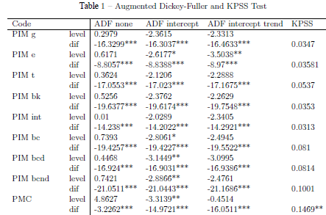
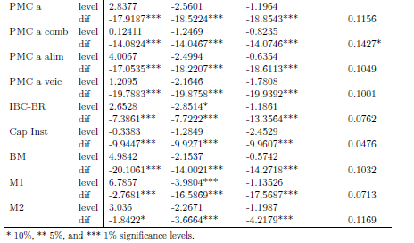
METHODOLOGY: DATA

Slide 9
METHODOLOGY: MIDAS IN ACTION
01
First Training Set
11 years: 2003M1 to 2014Q1
Training set recursively expanded
02
Total estimations
396 restricted MIDAS
1584 U-MIDAS
22 AR(1)
03
Lags and weights
MIDAS: scheme is endogenous
U-MIDAS: 3, 4, 5, and 6 lags
04
Model Evaluation
MSE ratio
Cumulative MSE ratio
DM test

Slide 10
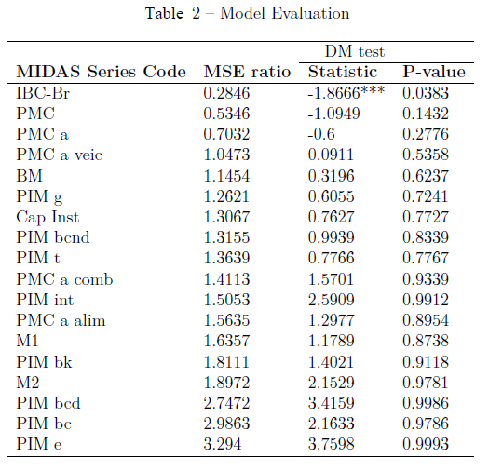
RESULTS: MIDAS EVALUATION
01
Under the MSE ratio, the restricted MIDAS with a normalized exponential Almon lag polynomial beats the benchmark when employing IBC-Br, retail sales, and amplified retail sales.
02
However, only the IBC-BR provides a statistically superior MIDAS specification (DM-test).

Slide 11
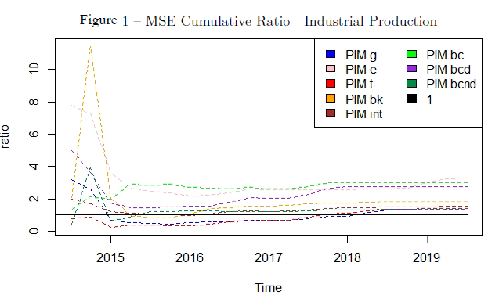
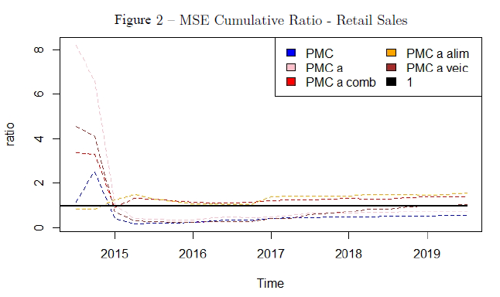
RESULTS: MSE CUMULATIVE RATIO

Slide 12
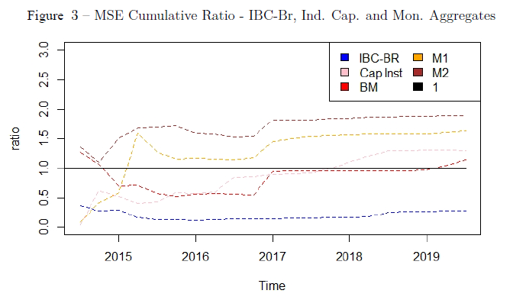
RESULTS: MSE CUMULATIVE RATIO
03
IBC-Br consistently beats the benchmark when employing restricted MIDAS with a normalized exponential Almon lag polynomial.
04
From 2014Q3 until the end of 2015, the cumulative MSE fraction for the monetary base consistently decreased. While this coefficient behavior might not be intrinsically related to the fiscal pedaling, its course provides an additional narrative to the economic policies during those.

Slide 13
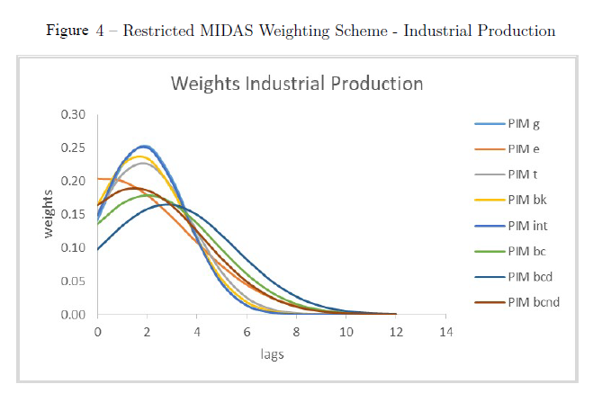
RESULTS: RESTRICTED MIDAS WEIGHTING SCHEME
The restricted MIDAS approach can include many lags without the proliferation of parameters.
05
Most weights peak on the first lags and then decay smoothly with almost no mass after the 12th lag.

Slide 14
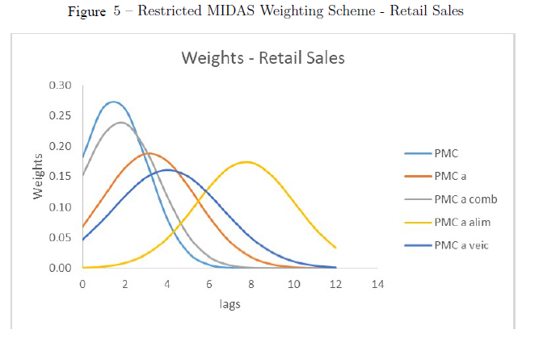
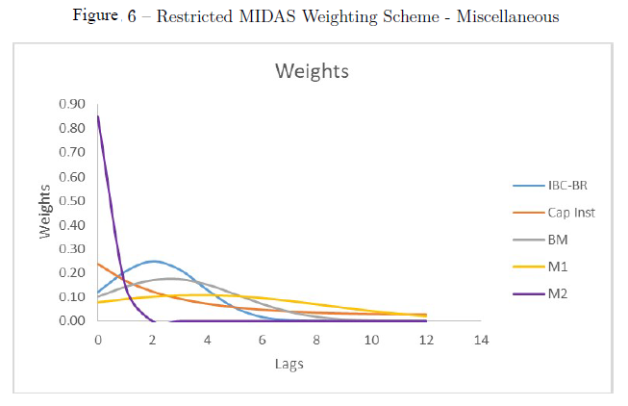
RESULTS: RESTRICTED MIDAS WEIGHTING SCHEME

Slide 15
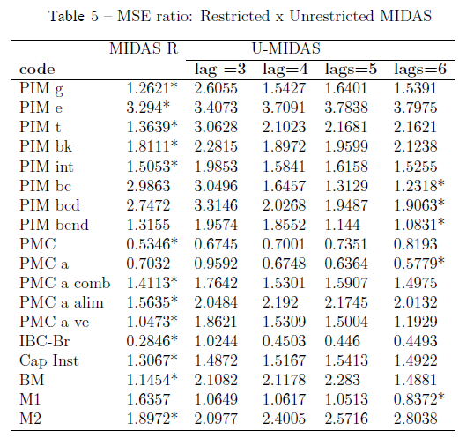
RESULTS: MIDAS X U-MIDAS
06
The restricted version also outperformed the U-Midas for the 11 out of 15 models that didn’t beat the benchmark.
07
IBC-Br based MIDAS achieved the minimum MSE within all the models, standing out as the utmost out-of-sample forecast.

Slide 16
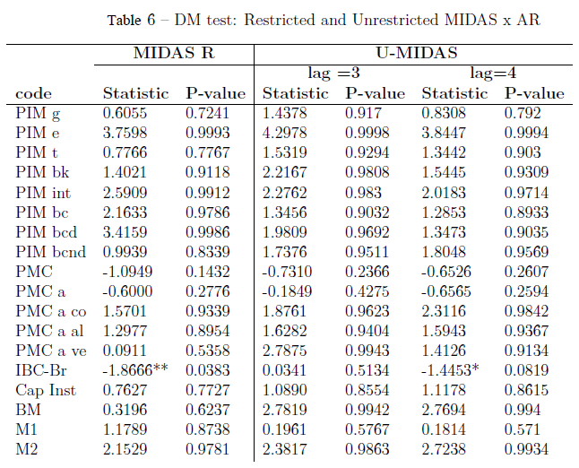
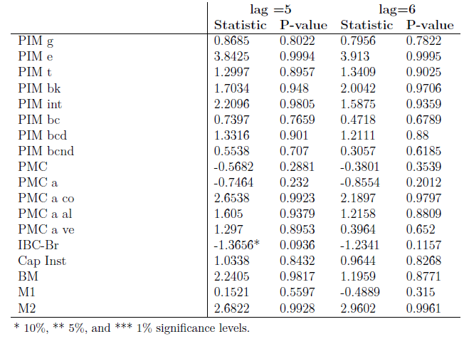
RESULTS: MIDAS X U-MIDAS

Slide 17
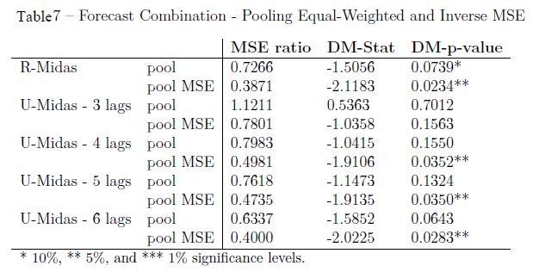
RESULTS: FORECASTS COMBINATIONS
08
As expected, the forecast combinations achieved better results than the single MIDAS models.
09
The inverse MSE weight promoted better results than the equal weighted combination.
10
The restricted Midas appears to provide better accuracy than the unrestricted framework.

Slide 18
CONTRIBUTIONS
02
This empirical application supports Midas implementation: it could significantly enhance GDP nowcast accuracy in Brazil.
01
To the author’s knowledge, this is the first study that applies MIDAS to nowcast GDP in Brazil using macroeconomic data. Although Zuanazzi and Ziegelmann (2014) had already implemented the MIDAS framework to forecast Brazilian GDP, their work targeted financial asset prices and did not include relevant macroeconomic indicators such as IBC-Br which this research showed that encompass the highest predictive content.
04
The constraints imposed by the Almon
polynomial seem reasonable and can well capture the underlying data generating process. Although Foroni, Marcellino, and Schumacher (2011) illustrate, through Monte Carlo simulations, that when sample differences between the dependent and independent variable is small, the U-MIDAS performance is similar to MIDAS, this work suggests that the restricted MIDAS might be advantageous even for macroeconomic applications with small frequency differences.
03
This study showcased that the money supply had an unprecedented predictive power to explain the GDP in Brazil from 2014Q3 to the end of 2015.

Slide 19
References:
ANDREOU, E.; GHYSELS, E.; KOURTELLOS, A. Should macroeconomic forecasters use daily financial data and how? Journal of Business & Economic Statistics, Taylor & Francis, v. 31, n. 2, p. 240–251, 2013.
BATES, J. M.; GRANGER, C. W. J. The combination of forecasts. The OR Society, 1969.
BERNANKE, B. S.; BOIVIN, J. Monetary policy in a data-rich environment. Journal of Monetary Economics, Elsevier, v. 50, n. 3, p. 525–546, 2003.
BREITUNG, J.; ROLING, C. Forecasting inflation rates using daily data: A nonparametric midas approach. Journal of Forecasting, Wiley Online Library, v. 34, n. 7, p. 588–603, 2015.
CLEMENTS, M. P.; GALVÃO, A. B. Macroeconomic forecasting with mixed-frequency data: Forecasting output growth in the united states. Journal of Business & Economic Statistics, Taylor & Francis, v. 26, n. 4, p. 546–554, 2008.
FORONI, C.; MARCELLINO, M.; SCHUMACHER, C. Unrestricted mixed data sampling (midas): Midas regressions with unrestricted lag polynomials. Journal of the Royal Statistical Society: Series A (Statistics in Society), Wiley Online Library, v. 178, n. 1, p. 57–82, 2015.
FORONI, C.; MARCELLINO, M. G. A survey of econometric methods for mixed-frequency data. Available at SSRN 2268912, 2013.
FORONI, C.; MARCELLINO, M. G.; SCHUMACHER, C. U-midas: Midas regressions with unrestricted lag polynomials. Bundesbank Series 1 Discussion Paper, 2011.
GHYSELS, E.; MARCELLINO, M. Applied economic forecasting using time series methods. [S.l.]: Oxford University Press, 2018.
GHYSELS, E.; OZKAN, N. Real-time forecasting of the us federal government budget: A simple mixed frequency data regression approach. International Journal of Forecasting, Elsevier, v. 31, n. 4, p. 1009–1020, 2015.
GHYSELS, E.; SANTA-CLARA, P.; VALKANOV, R. The midas touch: Mixed data sampling regression models. 2004.
GHYSELS, E.; SINKO, A.; VALKANOV, R. Midas regressions: Further results and new directions. Econometric Reviews, Taylor & Francis, v. 26, n. 1, p. 53–90, 2007.

Slide 20
References:
GHYSELS, E.; VALKANOV, R. I.; SERRANO, A. R. Multi-period forecasts of volatility: Direct, iterated, and mixed-data approaches. In: EFA 2009 Bergen Meetings
Paper. [S.l.: s.n.], 2009.
GODBOUT, C.; JACOB, J. Le pouvoir de prévision des indices PMI. [S.l.], 2010.
HARVEY, D.; LEYBOURNE, S.; NEWBOLD, P. Testing the equality of prediction mean squared errors. International Journal of forecasting, Elsevier, v. 13, n. 2, p.
281–291, 1997.
KUZIN, V.; MARCELLINO, M.; SCHUMACHER, C. Midas vs. mixed-frequency var: Nowcasting gdp in the euro area. International Journal of Forecasting, Elsevier, v. 27,
n. 2, p. 529–542, 2011.
LEBOEUF, M.; MOREL, L. Forecasting short-term real GDP growth in the euro area and Japan using unrestricted MIDAS regressions. [S.l.], 2014.
LI, X. et al. A midas modelling framework for chinese inflation index forecast incorporating google search data. Electronic Commerce Research and Applications,
Elsevier, v. 14, n. 2, p. 112–125, 2015.
MARCELLINO, M. Some consequences of temporal aggregation in empirical analysis. Journal of Business & Economic Statistics, Taylor & Francis Group, v. 17, n. 1, p.
129–136, 1999.
MARCELLINO, M.; SCHUMACHER, C. Factor midas for nowcasting and forecasting with ragged-edge data: A model comparison for german gdp. Oxford Bulletin of
Economics and Statistics, Wiley Online Library, v. 72, n. 4, p. 518–550, 2010.
MONTEFORTE, L.; MORETTI, G. Real-time forecasts of inflation: The role of financial variables. Journal of Forecasting, Wiley Online Library, v. 32, n. 1, p. 51–61, 2013.

Slide 21
References:
PAREDES, J.; PEDREGAL, D. J.; PÉREZ, J. J. Fiscal policy analysis in the euro area: Expanding the toolkit. Journal of Policy Modeling, Elsevier, v. 36, n. 5, p. 800–823,
2014.
SCHUMACHER, C.; BREITUNG, J. Real-time forecasting of german gdp based on a large factor model with monthly and quarterly data. International Journal of Forecasting, Elsevier, v. 24, n. 3, p. 386–398, 2008.
STOCK, J. H.; WATSON, M. W. Forecasting output and inflation: The role of asset prices. Journal of Economic Literature, v. 41, n. 3, p. 788–829, 2003.
ZUANAZZI, P.; ZIEGELMANN, F. Previsões para o crescimento do pib trimestral brasileiro com séries financeiras e economicas mensais: Uma aplicação de midas.
Economia Aplicada, Scielo, v. 18, n. 2, p. 295–318, 2014.

